Slide 1
Project 1-Ironhack Payments
Presentation
Jan, Georg, Iva

Slide 2
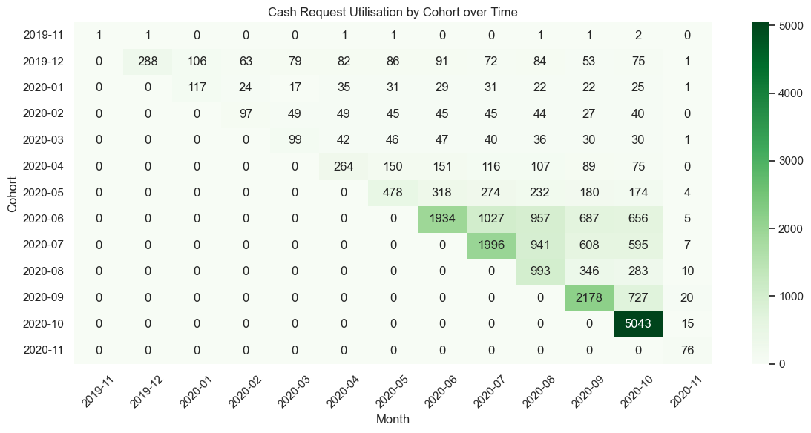
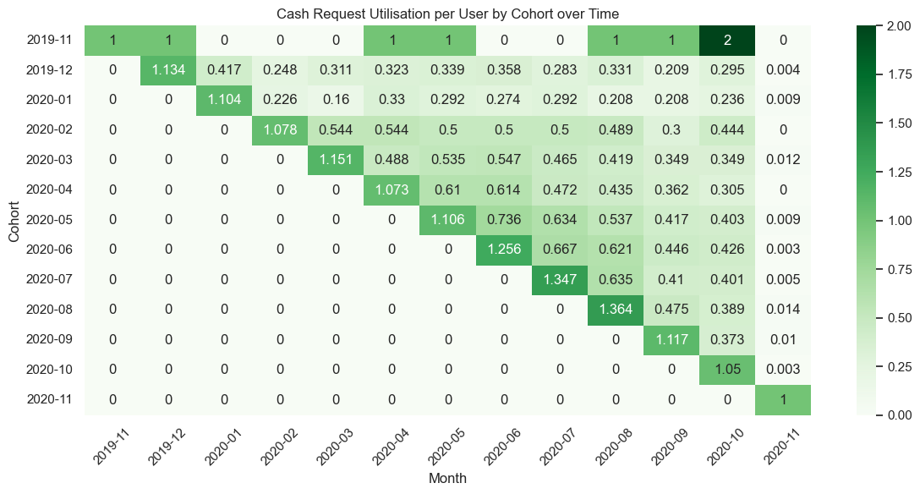
Frequency of service usage over time
Trends in absolute usage rates
drops in absolute initial usage between cohorts 2019-12 and 2020-04 and for cohort 2020-08
could be due to lower total number of eligible users
overall rising initial use
low interpretability of first and two newest cohorts
Average usage per user per cohort
typically >1 request per user in first month
high average use throughout for cohorts 2020-[03/05/06]

Slide 3
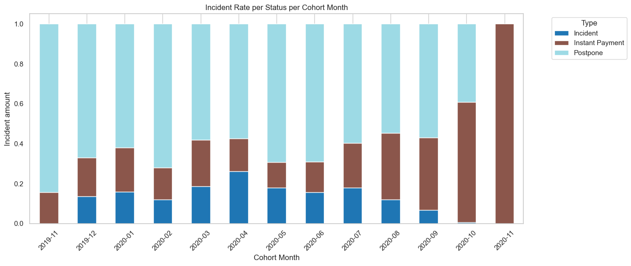
Incident Rates
each cash request can have additional fees.
visual displays number of Incidents per cohort
find problematic cohorts

Slide 4
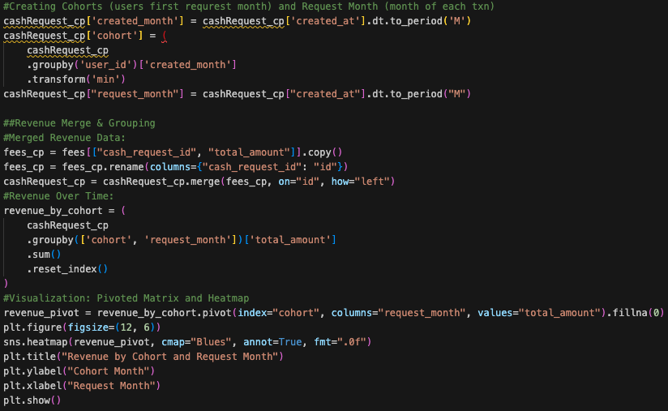
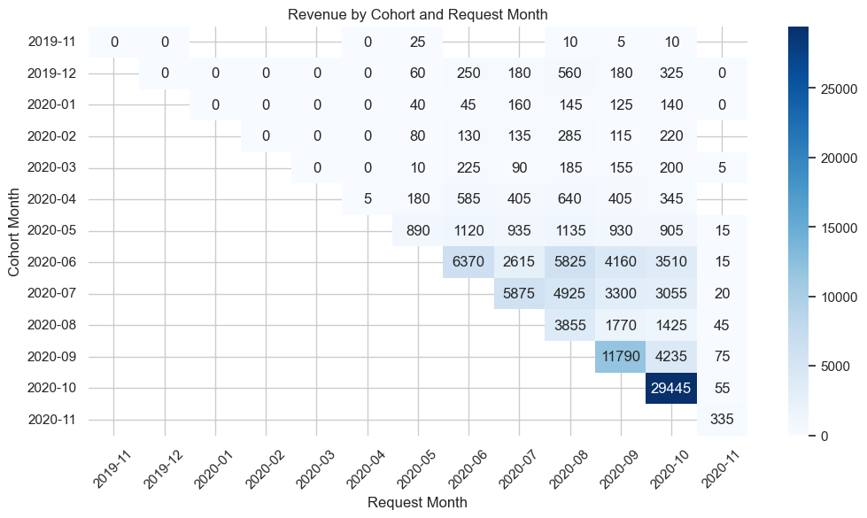
Task 3: Cohort Creation and Revenue Analysis
Heatmap:
Shows how revenue accumulates over time
Helps to visualize retention and monetization patterns
Most cohorts generate stronger early revenue
0’s = cohort was active but generated no revenue that month
Future steps:
Why do some cohorts drop off faster?
Why is revenue delayed until 2020-04?
Notes:
The code is a bit out of date, some minor changes to the heatmap, but the idea is still the same

Slide 5
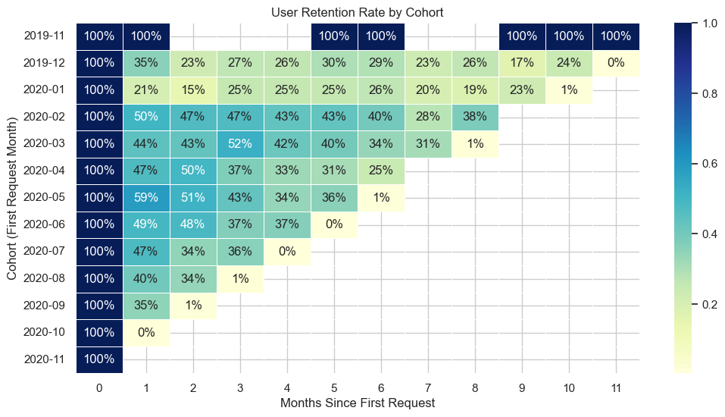
Retention Rate
rate of retention for each request month by cohort
How well do we retain users that onboarded in a specific month?

